Slide 1
PNEUMATIC PEDAL VALVE OPERATED HOLE PUNCHING MACHINE
RINSHADUL NISHAM
ASHWIN
KAVIPRASHAAD

Slide 2
INTRODUCTION
The switch controlled hole-punching machine is designed for efficient hole creation in extended polypropylene components.
It utilizes pneumatic cylinders for vertical and horizontal punching.Vertical cylinders have heating solders for precise hole creation, while horizontal cylinders are used for side punching.
The machine's operation is controlled via a electric pedal switch, allowing for precise and hands-free operation.The support frame, guide rods, and various fasteners ensure stability and accuracy during operation.
Estimated component costs are provided to help understand the overall investment required to build or purchase such a machine.
The switch-controlled hole-punching machine offers precise and efficient hole creation for extended polypropylene components.
Its design and operation provide stability, accuracy, and hands-free control.
Understanding the estimated component costs is crucial for decision-making regarding the implementation of this machine..

Slide 3
BASIC METHODOLOGY
Setup: Position the machine on a stable surface, ensuring correct assembly.
2. Position Adjustment: Modify the vertical and horizontal pneumatic cylinders to the desired positions and hole diameters.
3. Heating Activation: Activate the heating solders on the vertical cylinders to preheat the hole-making tools.
4. Material Placement: Position the extended polypropylene components on the base plate.
5. Switch Control: Initiate the operation by pressing the switch.

Slide 4
6. Vertical Hole Punching: Utilize the preheated vertical cylinders to vertically punch holes into the polypropylene.
7. Horizontal Hole Punching: Employ the horizontal cylinders to punch holes into the sides of the material.
8. Completion: Cease operation and remove the finished material by releasing the foot valve. This machine utilizes pneumatic control and heating elements to facilitate precise and efficient hole punching in polypropylene components.
This machine utilizes pneumatic control and heating elements to facilitate precise and efficient hole punching in polypropylene components.

Slide 5
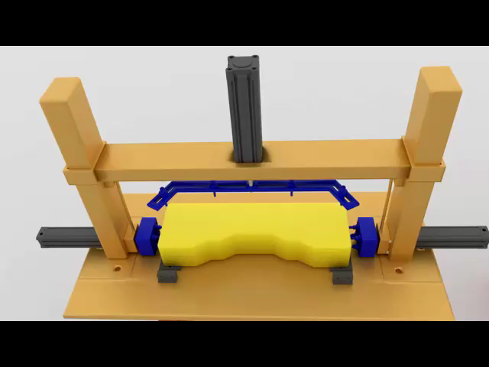
MECHANICAL DESIGNS

Slide 6
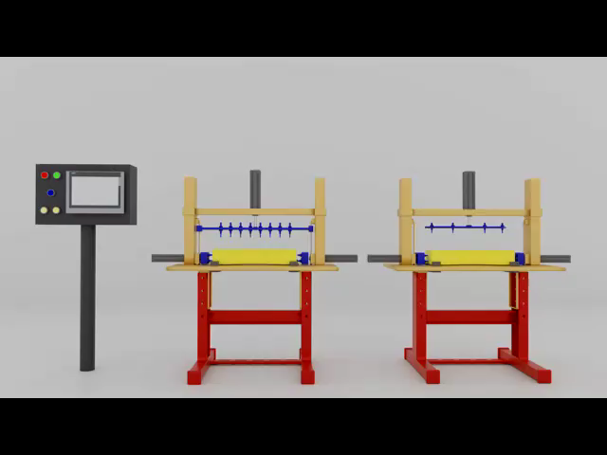
MECHANICAL DESIGNS

Slide 7
BRIEF DESCRIPTION OF EACH COMPONENTS (MECHANICAL)
SUPPORT BASE AND FRAME :
The frame provides structural integrity, while the base offers a flat working surface. It is typically made of stainless steel or aluminum.
ALUMINIUM :
Pros: Lightweight, resistant to corrosion, easy to machine, and adequate strength for most applications.
Cons: Lower strength compared to steel, can be more expensive.
Cost: ₹150 - ₹200 per kg.
STAINLESS STEEL :
Pros: Combines the strength of steel with superior corrosion resistance, low maintenance
Cons: More expensive and heavier than aluminum
Cost: ₹200 - ₹250 per kg.

Slide 8
GUIDE RODS AND GUIDE WAYS
Function and Importance:
Stability and Precision:
Guide rods ensure precise linear movement of the pneumatic cylinders, maintaining alignment and preventing wobbling.
Load Distribution:
They evenly distribute the load, reducing wear and tear on the cylinders and other moving parts.
Support:
They support the weight of the moving parts, enhancing the machine's durability and longevity.

Slide 9
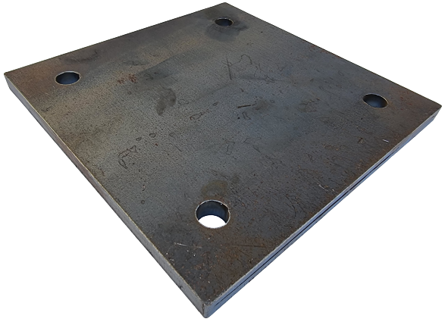
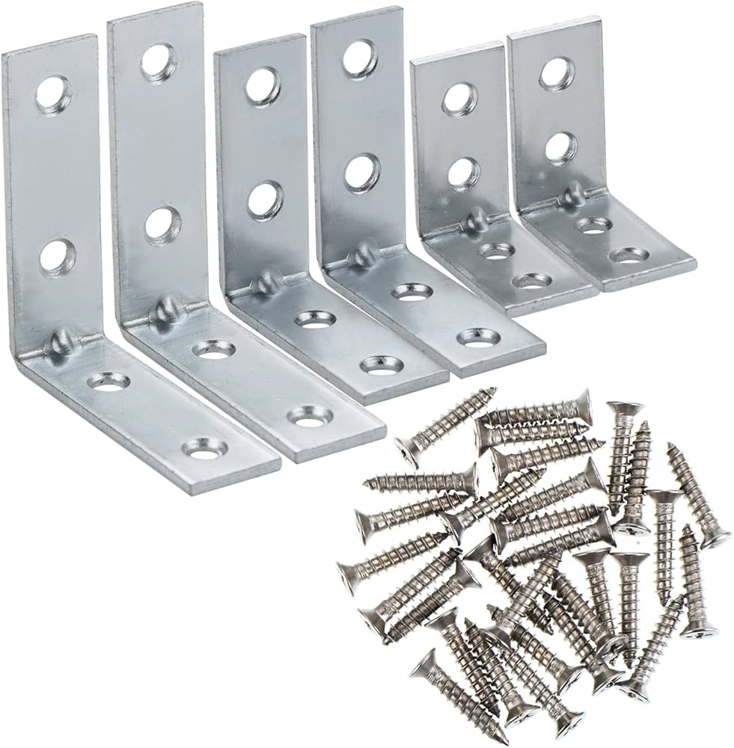
BASE PLATE:
Description: The flat surface where the workpiece is placed. It may have markings or guides to assist in positioning the material
MOUNTING BRACKETS AND FASTENERS :
Description: These components are used to assemble and secure the machine parts. They ensure stability and alignment of moving parts.

Slide 10
Modular Soldering Tool Arrangement for Vertical Pneumatic Cylinders :
Components and Features:
Interchangeable Soldering Tips:
Variety: Different sizes and shapes to create holes of varying diameters.
Attachment: Quick-change mechanism for easy swapping.
Adjustable Mounting Bracket:
Function: Allows the soldering tool to be positioned at various distances from the workpiece.
Adjustment: Screw or lever mechanisms for precise positioning.

Slide 11
Height Adjustment Mechanism:
Function: Enables vertical movement to adjust the depth of the hole.
Type: Manual or motorized screw jacks, pneumatic lifts.
Range: Typically a few centimeters to accommodate different material thicknesses

Slide 12
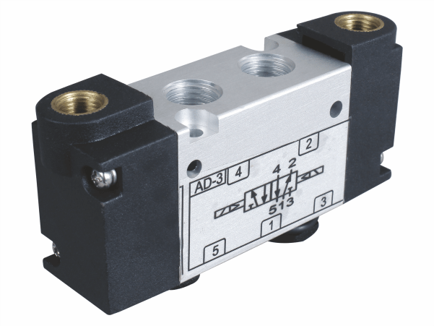
BRIEF DESCRIPTION OF EACH COMPONENTS (PNEUMATICS)
PILOT OPERATED DIRECTIONAL CONTROL VALVE
A pilot-operated directional control valve (DCV) is a type of valve that uses a small pilot valve to control a larger main valve. The pilot valve directs air to the larger valve, causing it to shift positions and control the flow of the main air supply. This type of valve is commonly used in pneumatic systems to manage the flow and direction of compressed air with high efficiency and reliability.
Cost:
Typically ranges from ₹2,000 to ₹5,000 each, depending on size, material, and brand.

Slide 13
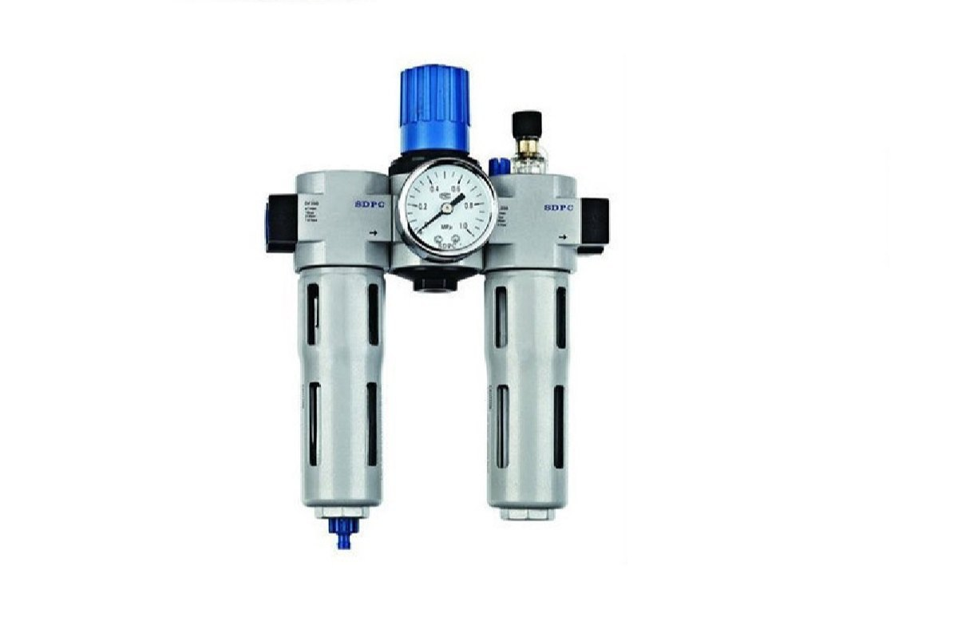
FRL UNIT (OPTIONAL)
An FRL unit (Filter, Regulator, and Lubricator) is a crucial component in pneumatic systems used to prepare and maintain the quality of compressed air. It ensures that the air supplied to the pneumatic components is clean, at the correct pressure, and adequately lubricated.
Cost:
Typically ranges from ₹3,000 to ₹8,000, depending on size, quality, and brand

Slide 14
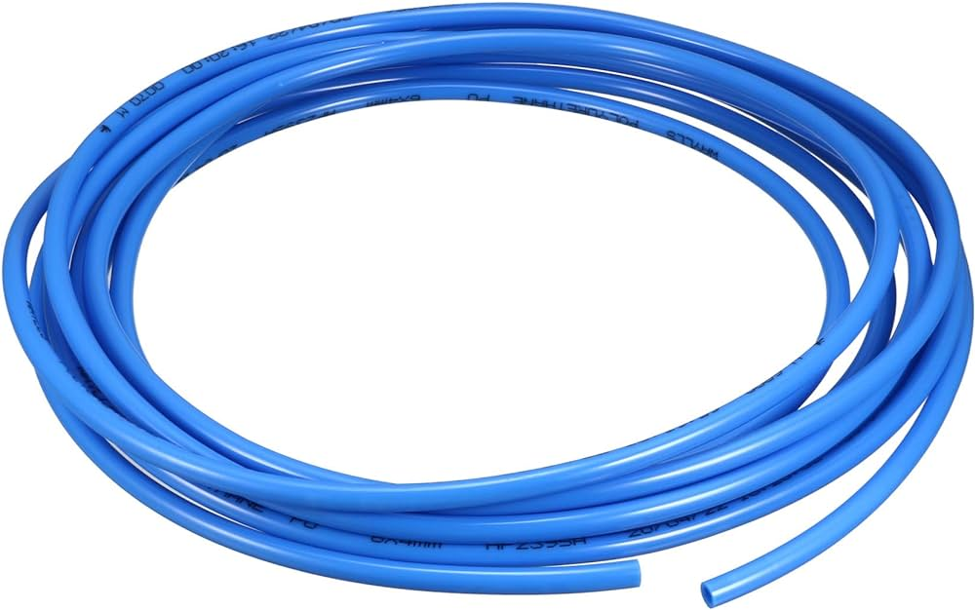
POLYURETHANE PNEUMATIC TUBES
Pneumatic polyurethane pipes are flexible tubing used to convey compressed air in pneumatic systems. They are made from polyurethane, which combines the best properties of plastic and rubber, making them ideal for pneumatic applications. Pneumatic polyurethane pipes are essential for conveying compressed air in pneumatic systems due to their flexibility, durability, chemical resistance, and ability to handle high pressures. They are widely used in industrial applications and are cost-effective, making them a popular choice for pneumatic tubing.
Average Cost:
Per Meter: ₹20 - ₹50, depending on the diameter and quality.

Slide 15
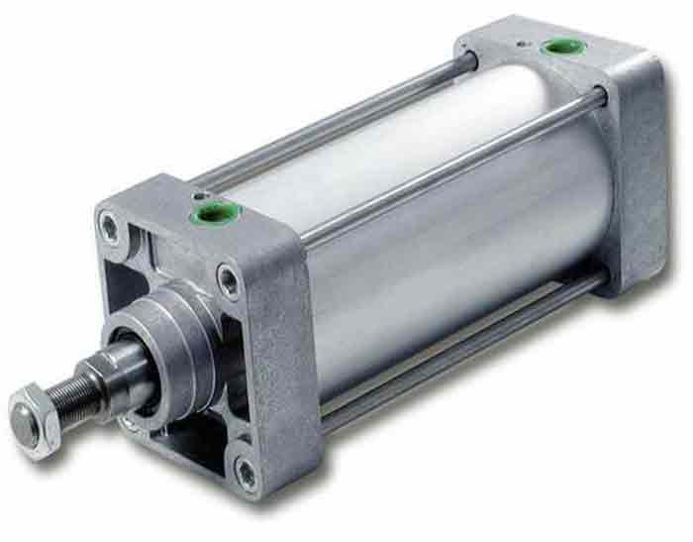
SINGLE ACTING PNEUMATIC CYLINDERS :
Single-acting pneumatic cylinders are actuators that use compressed air to produce motion in one direction. The return movement is achieved either by a spring inside the cylinder or by the load's force. These cylinders are commonly used in applications where a return stroke requires less force or can be achieved by other means.
COST : Average cost of 1000mm stroke cylinder costs around ₹6000.
Operation:
Actuation:
Compressed air is introduced into the cylinder through an air port, pushing the piston forward.
Return Stroke:
In spring-return models, once the air pressure is released, the internal spring pushes the piston back to its original position.
In other models, the return is achieved by an external force or gravity.

Slide 16
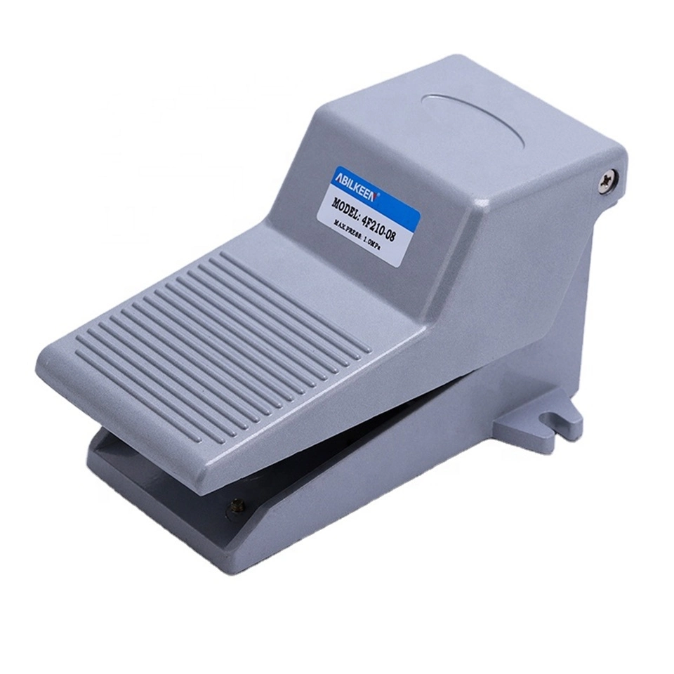
Pneumatic Foot Pedal Switch
Description:
A electricfoot switch is a manually operated device that controls the flow of compressed air to pneumatic systems. By pressing the pedal, the operator can start, stop, or modulate the flow of air, allowing for hands-free control of pneumatic cylinders and other actuators.
Operation:
Pressing the Pedal:
When the operator presses the pedal, it shifts the internal spool or poppet, opening the air pathway and allowing compressed air to flow to the connected pneumatic system.
Releasing the Pedal:
The return spring pushes the pedal back to its original position, closing the valve and stopping the air flow.
COST : AVERAGE COSTS AROUND ₹1000.

